Slide 1



Software engineering (Undergraduate)
Chapter 1 software & software engineering
Course Name software engineering
CSC 3114
(Undergraduate)
M. Mahmudul hasan
Assistant Professor, CS, AIUB
http://www.dit.hua.gr/~m.hasan

Slide 2
Why system fails?
Slide-2
The system fails to meet the business requirements for which it was developed. The system is either abandoned or expensive adaptive maintenance is undertaken.
There are performance shortcomings in the system, which make it inadequate for the users’ needs. Again, it is either abandoned or amended incurring extra costs.
Errors appear in the developed system causing unexpected problems. Patches have to be applied at extra cost.
Users reject the implemented system, lack of involvement in its development or lack of commitment to it.
Systems are initially accepted but over time become un-maintainable and so pass into disuse.
MMH

Slide 3
Scope of software Engineering
Slide - 2
The aim of Software Engineering is to solve Software Crisis:
Late
Over budget
Low quality with lots of faults
Software crisis is still present over 35 years later!
MMH

Slide 4
Software characteristics
Slide - 3
A logical (intangible) rather than a physical system element
Being developed or engineered, but not being manufactured
Software cost concentrating in engineering, not in materials
Software does not “wearing out” but “deteriorating”(not destroyed after lifetime like hardware, but backdated by aging that needs to update)
Software is a ‘differentiator’ (different sub-systems, e.g. cashier’s workstation in a supermarket)
Without “spare parts” in software maintenance (no extra useless features in software)
Most software continuing to be custom built (based on the requirements)
MMH

Slide 5
Goal: Computer science vs. Software engineering
Slide - 4
CS: to investigate a variety of ways to produce S/W, some good and some bad
SE: to be interested in only those techniques that make sound economic sense
MMH

Slide 6
Software development life cycle (SDLC)
Slide - 5
A structured set of activities required to develop a software system
The way we produce software, including:
Requirements Analysis
Designing/Modeling
Coding /Development
Testing
Implementation/Integration phase
Operation/Maintenance
Documentation
MMH

Slide 7
Good & bad software
Slide - 6
Good software is maintained—bad software is discarded
Different types of maintenance
Corrective maintenance [about 20%]
Modification to fix a problem
Enhancement [about 80%]
Perfective maintenance (modification to improve usability,…) [about 60%]
Adaptive maintenance (modification to keep up-to-date) [about 20%]
Preventive maintenance (modification to avoid any future error) [about 20%]
MMH

Slide 8
Faults in software development phases
Slide - 7
60 to 70 percent of faults are specification and design faults
Data of Kelly, Sherif, and Hops [1992]
1.9 faults per page of specification
0.9 faults per page of design
0.3 faults per page of code
Data of Bhandari et al. [1994]
Faults at end of the design phase of the new version of the product
13% of faults from previous version of product
16% of faults in new specifications
71% of faults in new design
MMH

Slide 9
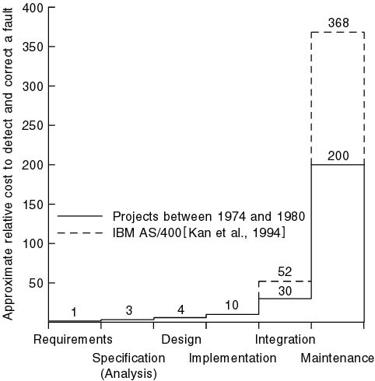
Cost of detection & correction of a fault
Slide - 8
MMH

Slide 10
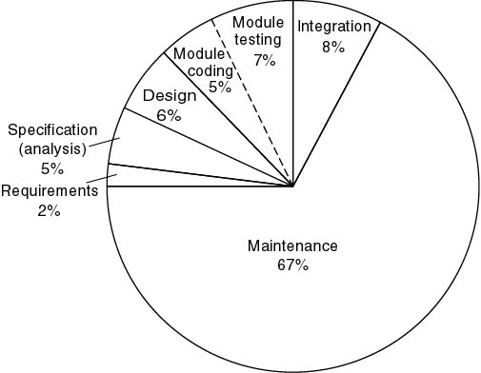
Cost of detection & correction of a fault
Slide - 9
MMH

Slide 11
Cost of change
Slide - 10
MMH

Slide 12
Product bathtub curve model
Slide - 11
“Infant Mortality” --
due to design or
manufacturing defects
Failure Rate
“deteriorating” --
due to cumulative
affects of environments
Time
MMH

Slide 13
Software idealized curve
Slide - 12
Failure Rate
Idealized Curve
Time
MMH

Slide 14
Software actual failure curve
Slide - 13
Increased failure rates
due to side effects
Failure Rate
Actual Curve
Change
Idealized Curve
Time
MMH

Slide 15
what is Software engineering?
Slide - 14
Technologies that make it easier, faster, and less expensive to build high-quality computer programs
A discipline aiming to the production of fault-free software, delivered on time and within budget, that satisfies the users’ needs
An engineering: set of activities in software production
The philosophy and paradigm of established engineering disciplines to solve what are termed software crisis
MMH

Slide 16
Software application
Slide - 15
System software (control computer H/W such as OS)
Business software (commercial application for business users, SAP, ERP)
Engineering and scientific software (e.g. statistical analysis-SPSS, matlab)
Embedded software (e.g. auto pilot, biometric device)
Personal computer software (e.g. Microsoft Office)
Web-based software (use over internet with browser, e.g. Gmail)
Artificial intelligence software (interact with computer, HCI, game)
MMH

Slide 17
Software Myths (management)
Slide - 16
Myth1: We already have a book that’s full of standards and procedures for building s/w, won’t that provide my people with everything they need to know?
Myth2: My people have state-of-the-art software development tools, after all, we buy them the newest computers.
Myth3: If we get behind schedule, we can add more programmers and catch up.
Myth4: If I decide to outsource the software project to a third party, I can just relax and let that firm build it.
MMH

Slide 18
Software Myths (customer)
Slide - 17
Myth1: A general statement of objectives is sufficient to begin writing programs – we can fill in the details later.
Myth2: Project requirements continually change, but change can be easily accommodated because software is flexible.
MMH

Slide 19
Software Myths (practitioner)
Slide - 19
Myth1: Once we write the program and get it to work, our job is done.
Fact: the sooner you begin writing code, the longer it will take you to get done.
Myth2: Until I get the program “running,” I have no way of assessing its quality.
Myth3: The only deliverable work product for a successful project is the working program.
Myth4: Software engineering will make us create voluminous and unnecessary documentation and will invariable slow us down.
MMH

Slide 20
references
Slide - 20
R.S. Pressman & Associates, Inc. (2010). Software Engineering: A Practitioner’s Approach.
Kelly, J. C., Sherif, J. S., & Hops, J. (1992). An analysis of defect densities found during software inspections. Journal of Systems and Software, 17(2), 111-117.
Bhandari, I., Halliday, M. J., Chaar, J., Chillarege, R., Jones, K., Atkinson, J. S., & Yonezawa, M. (1994). In-process improvement through defect data interpretation. IBM Systems Journal, 33(1), 182-214.

